Slide 1
31 Addison
Scoudouc, NB
z

Slide 2
The Location – Scoudouc Industrial Park
Directly Off of Highway 15
4 Km from the trans Canada highway
24 Businesses with over 650 employees

Slide 3
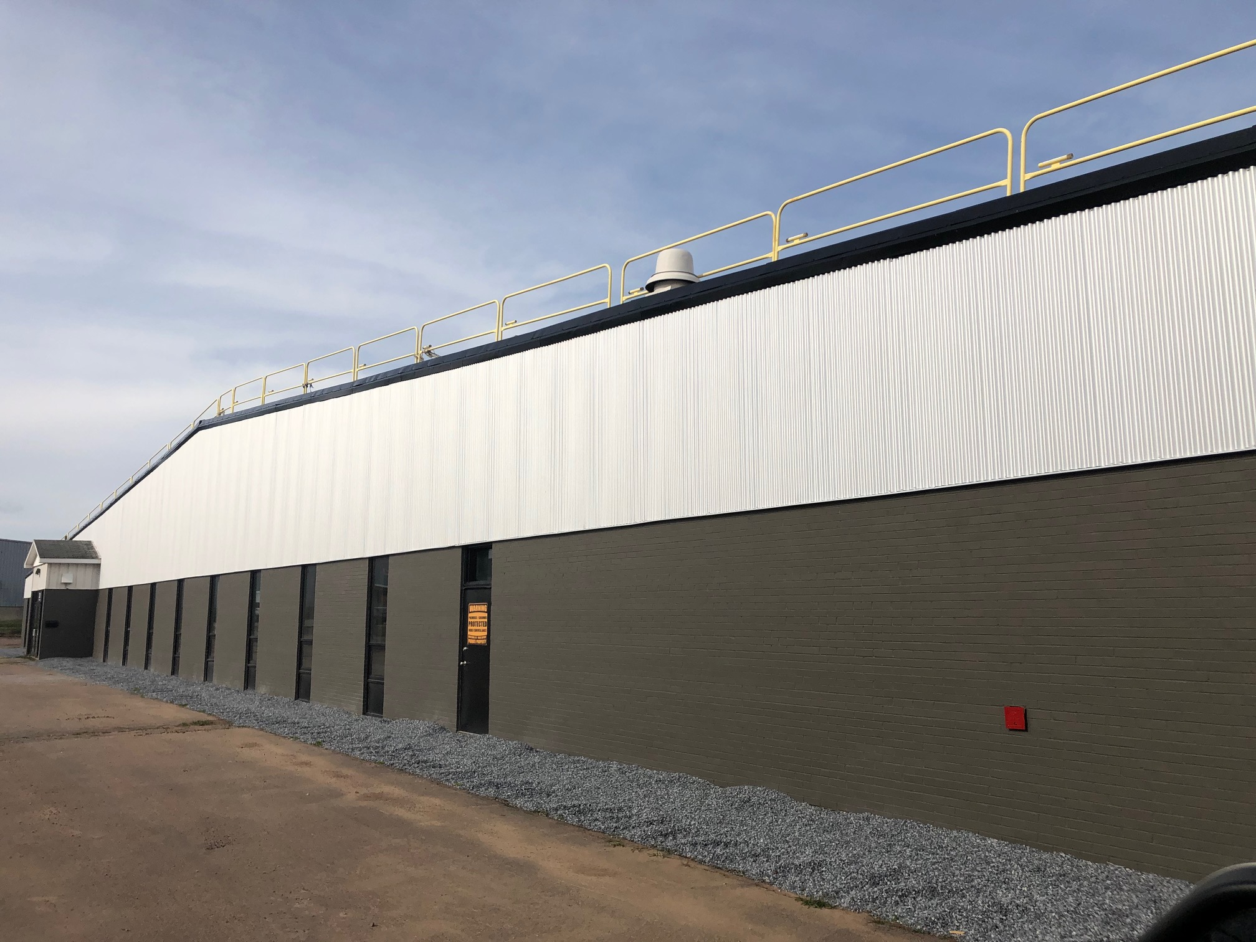
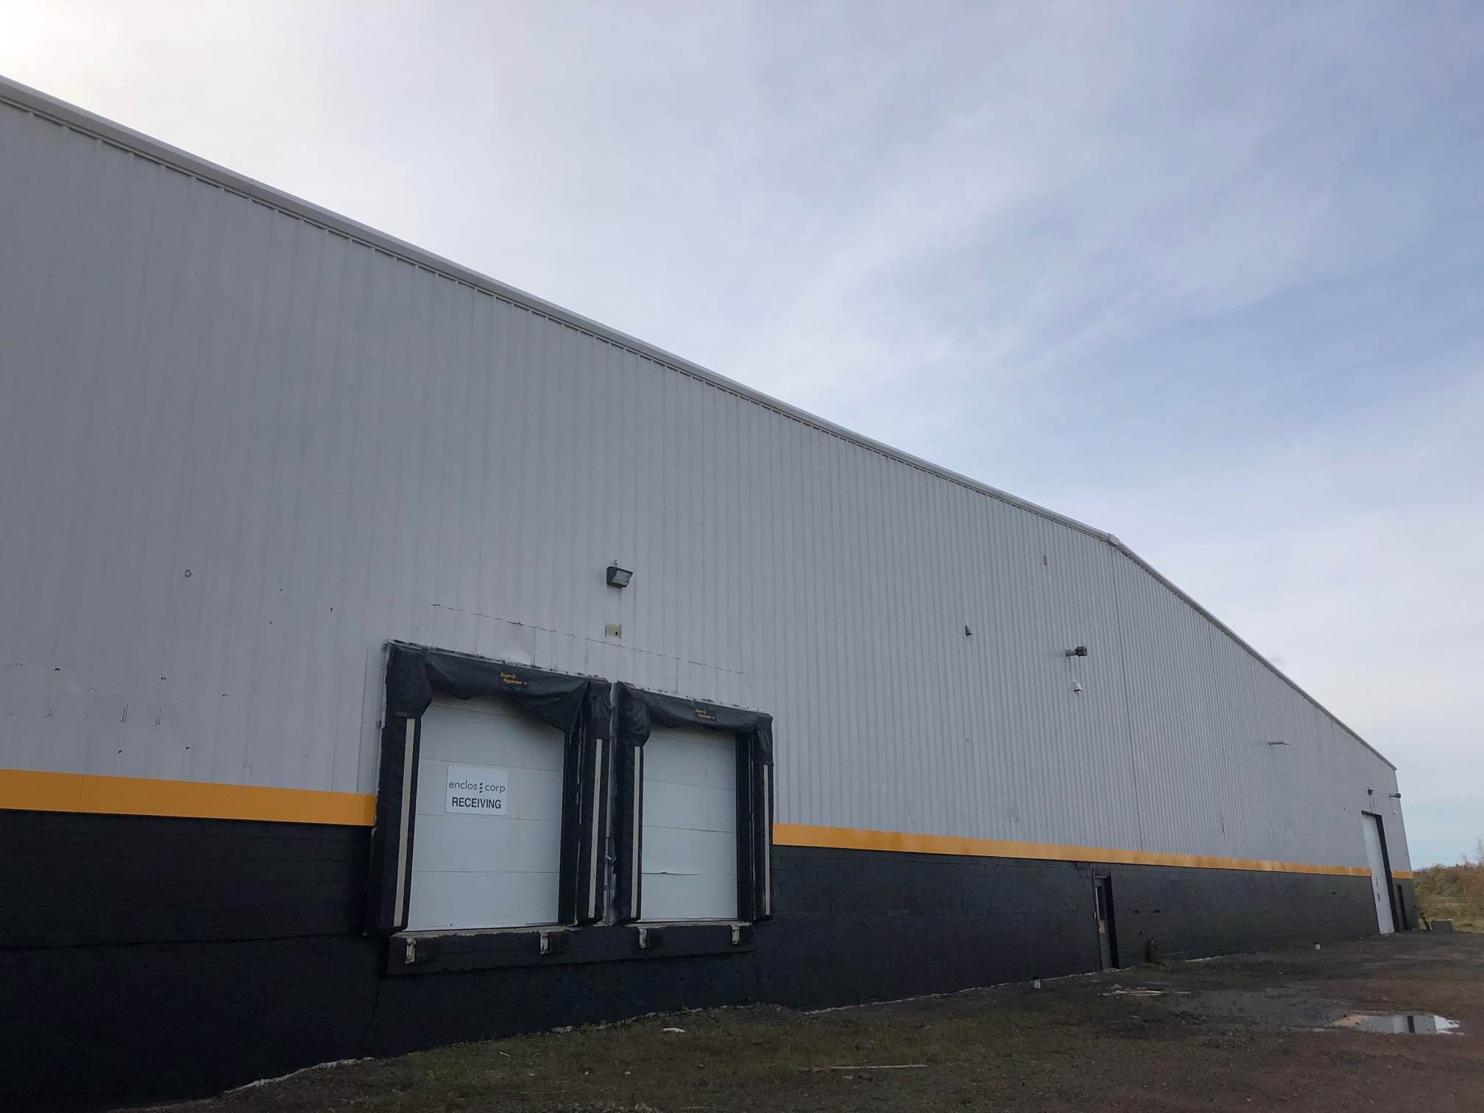
The Exterior
+/- 9 Acres
Extra Large Fenced Yard Space
Ample Parking
New Modern Façade

Slide 4
Site Plan

Slide 5
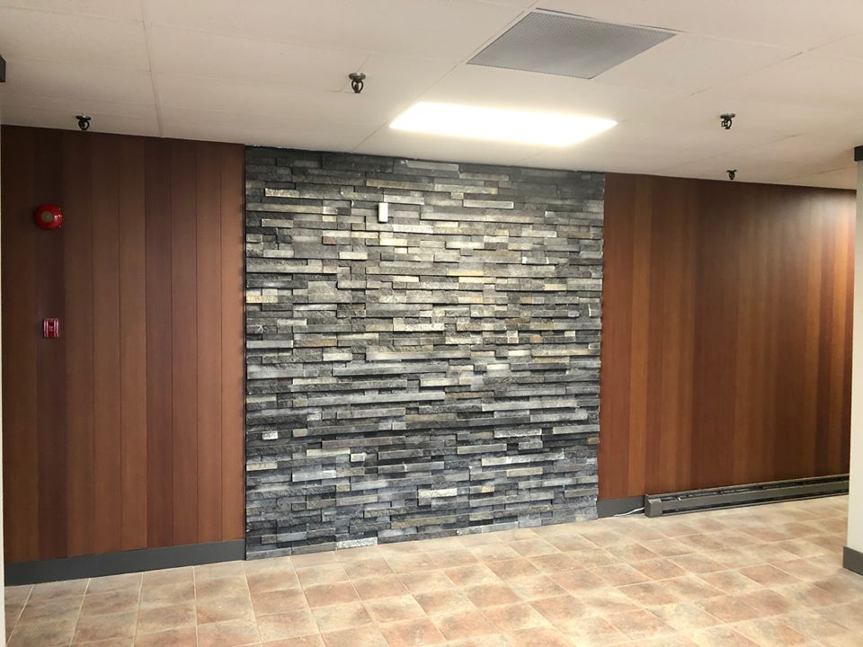
The Interior
z
15+ Private Offices (8,000 SF)
Board Rooms
Lunch Rooms
Large Reception/Entrance Area
LED Lighting
Natural Light Throughout

Slide 6
The Floor Plan
z

Slide 7
The Warehouse
30 Foot Clear Ceiling Height
LED Lighting
Big Ass Fan
Honeywell Temperature Control
600 Amp/3 Phase/4 Wire/600 Volt
4 Large Grade Doors/4 Dock Doors/With New Heavy Duty Levelers

Slide 8
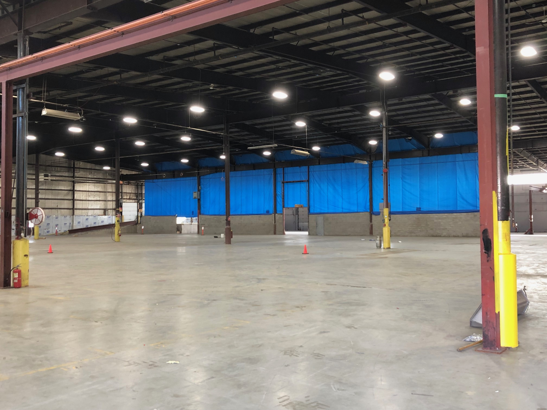
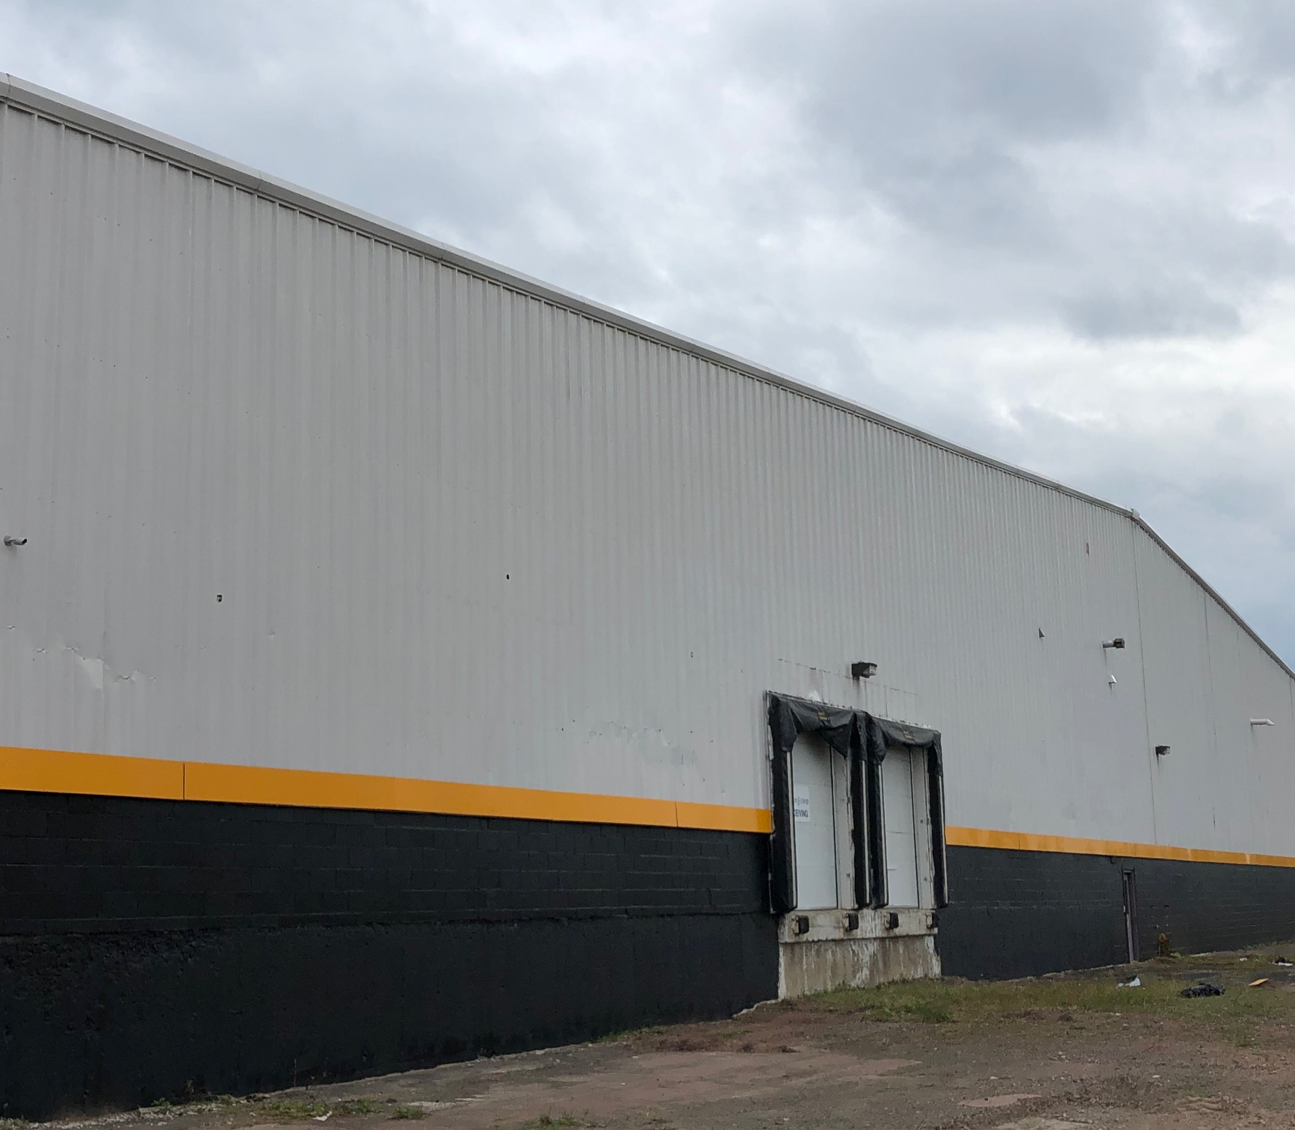
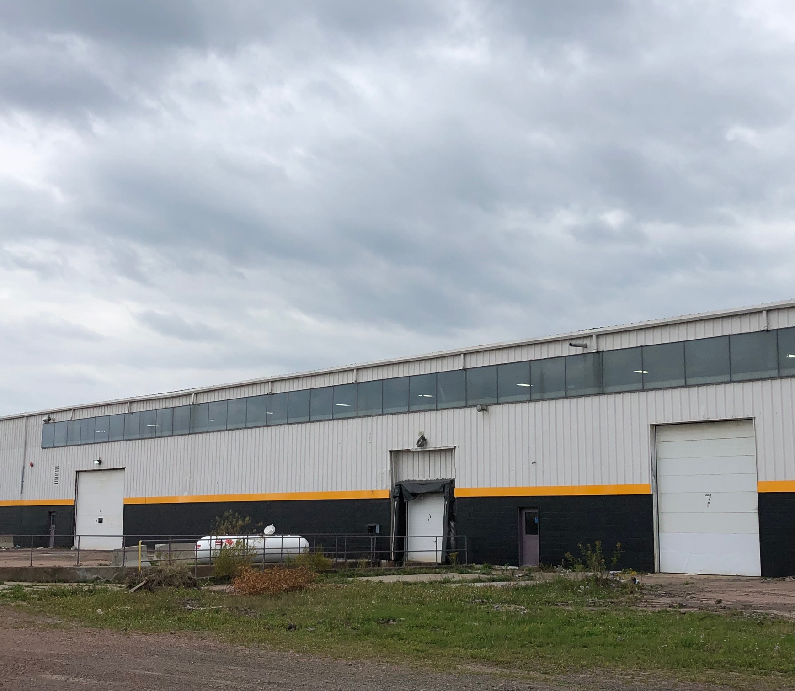
The Warehouse

Slide 9
Contact Atlantic Commercial Properties
z
Kimberly MacLean
Leasing Manager
506 853 8000
leasing@acpleasing.com
Acpleasing.com

