Slide 1
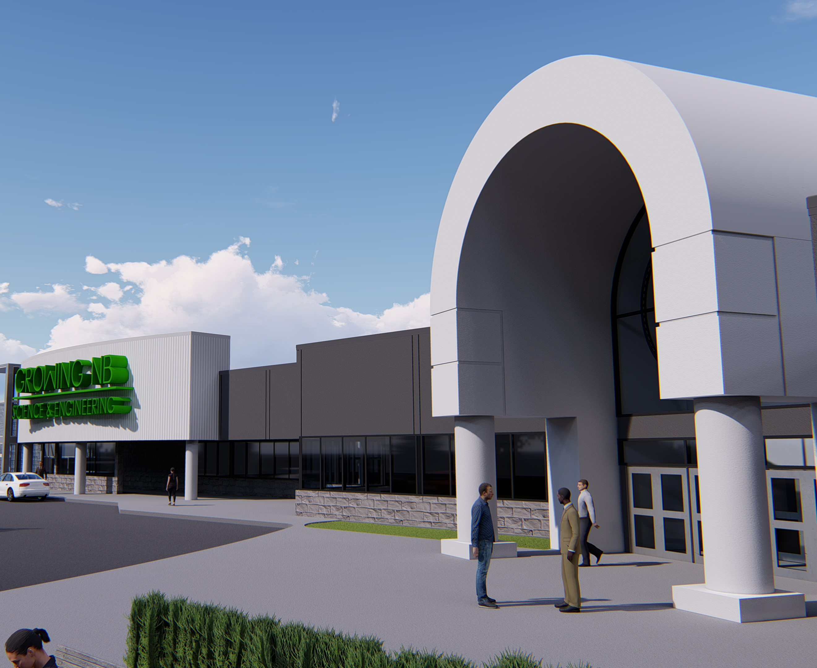

Prime Business Development
In Sussex, NB

Slide 2
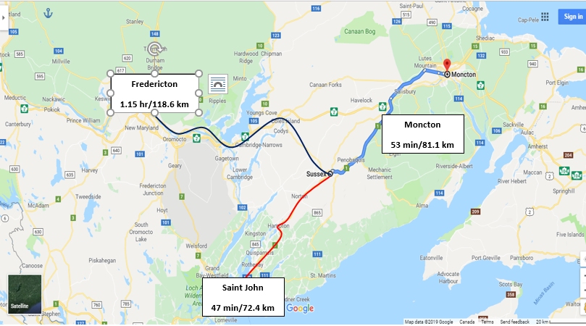
The HUB of New Brunswick

Slide 3
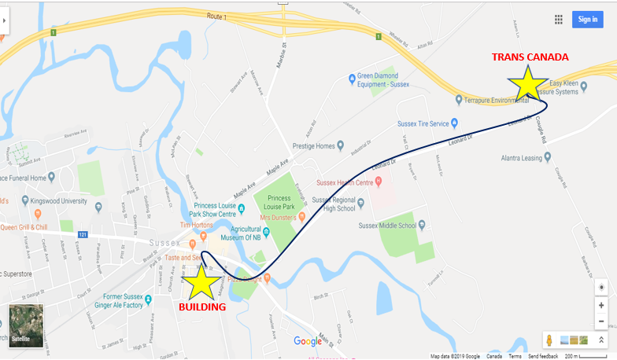
Prime Downtown Location
Close to Trans Canada Highway

Slide 4
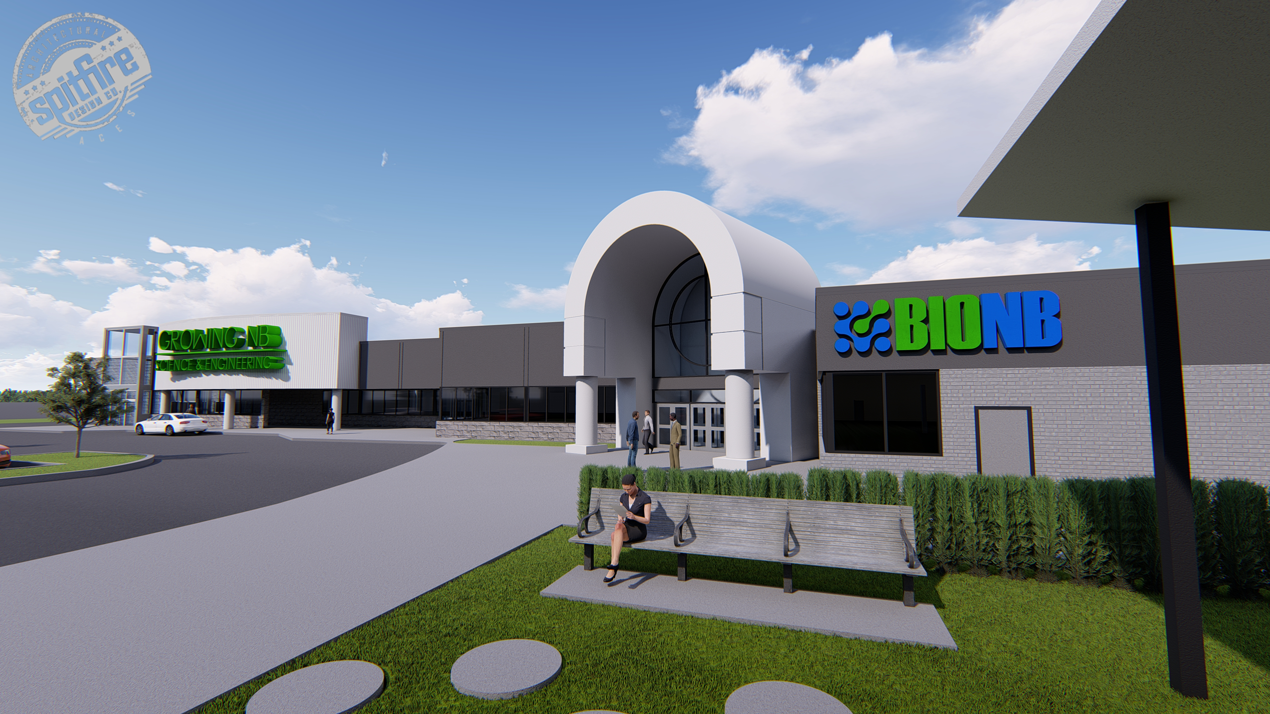
Building Details
The current building is 115,000 SF on 1 level with the possibility for a new look based upon your company profile and room for building expansion. The total lot size is +/- 13 Acres.

Slide 5
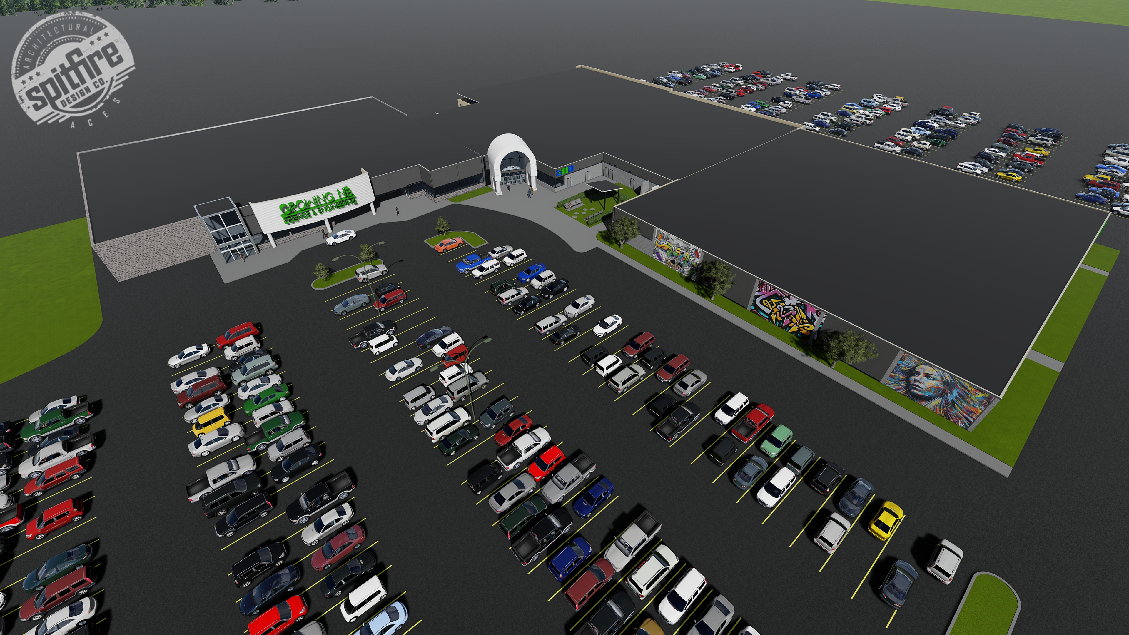
700 Parking Spaces

Slide 6
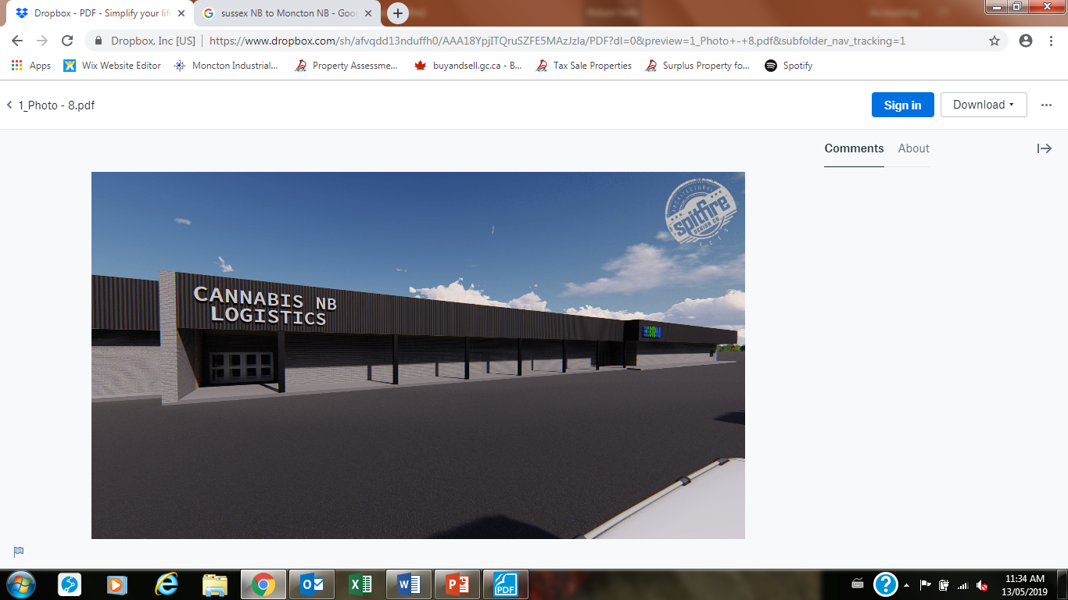
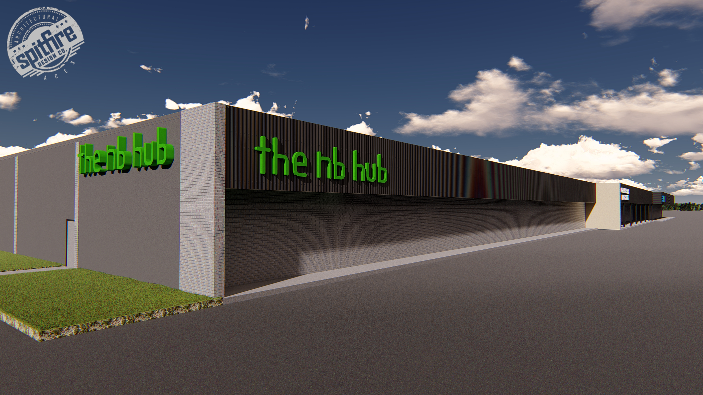
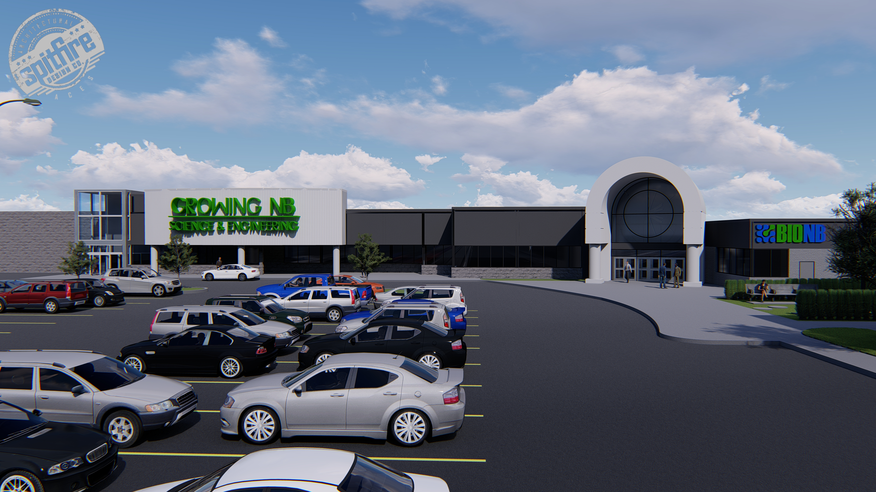
Professional Business Opportunities

Slide 7
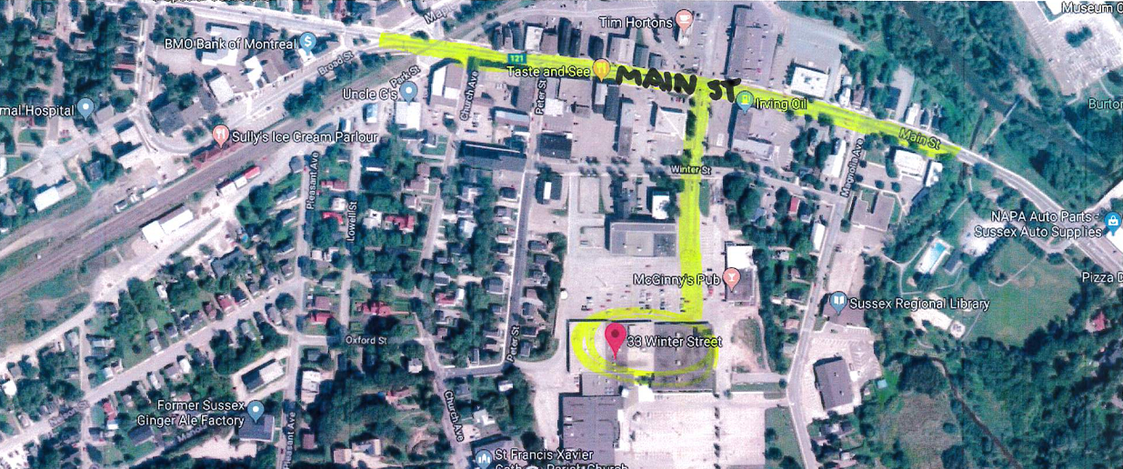
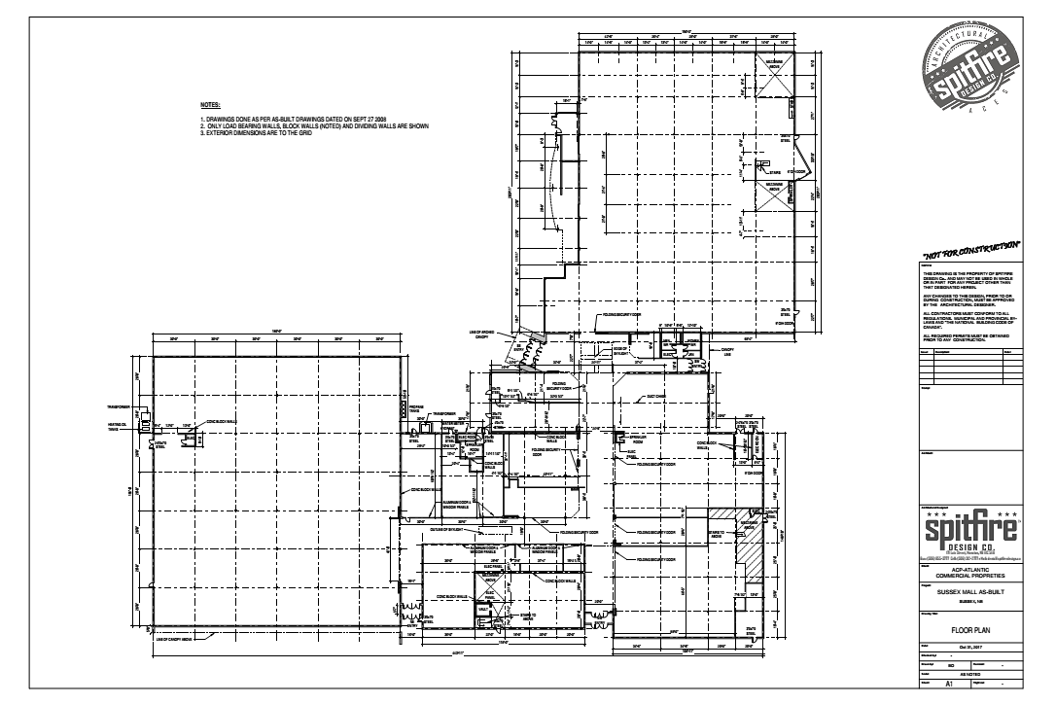
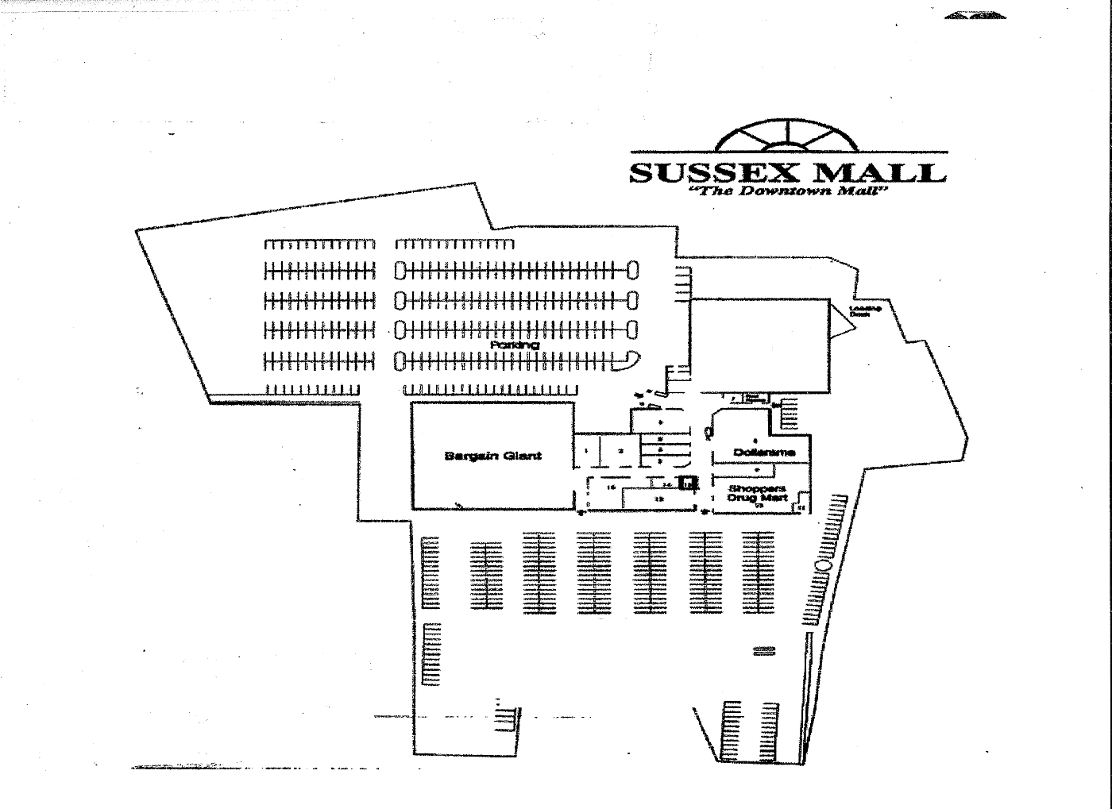
Supporting Documents

Slide 8

Contact Atlantic Commercial Properties
Gordon Lahanky
President
506 853 8000
leasing@acpleasing.com
Acpleasing.com

