Slide 1
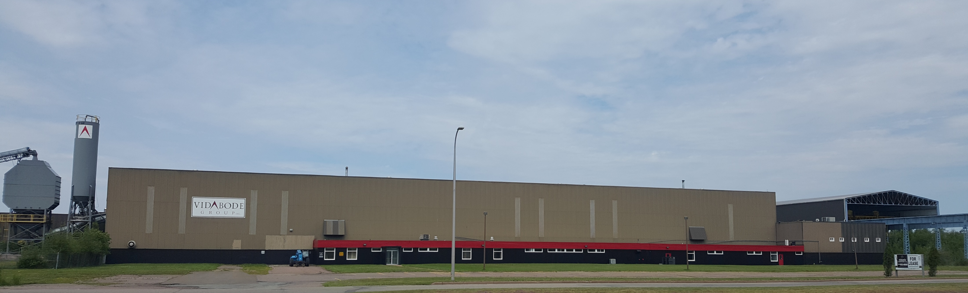
1 Chandler
Amherst, NS

Slide 2
The Location
Atlantic Commercial Properties is ready to assist your business in finding the right building to grow. 1 Chandler is located in the Amherst Industrial Park which is home to companies in aerospace, green technology, food processing, manufacturing, and distribution sectors. Our 27-acre property is in the geographic centre of Atlantic Canada with easy access to road, rail, air, and sea.

Slide 3
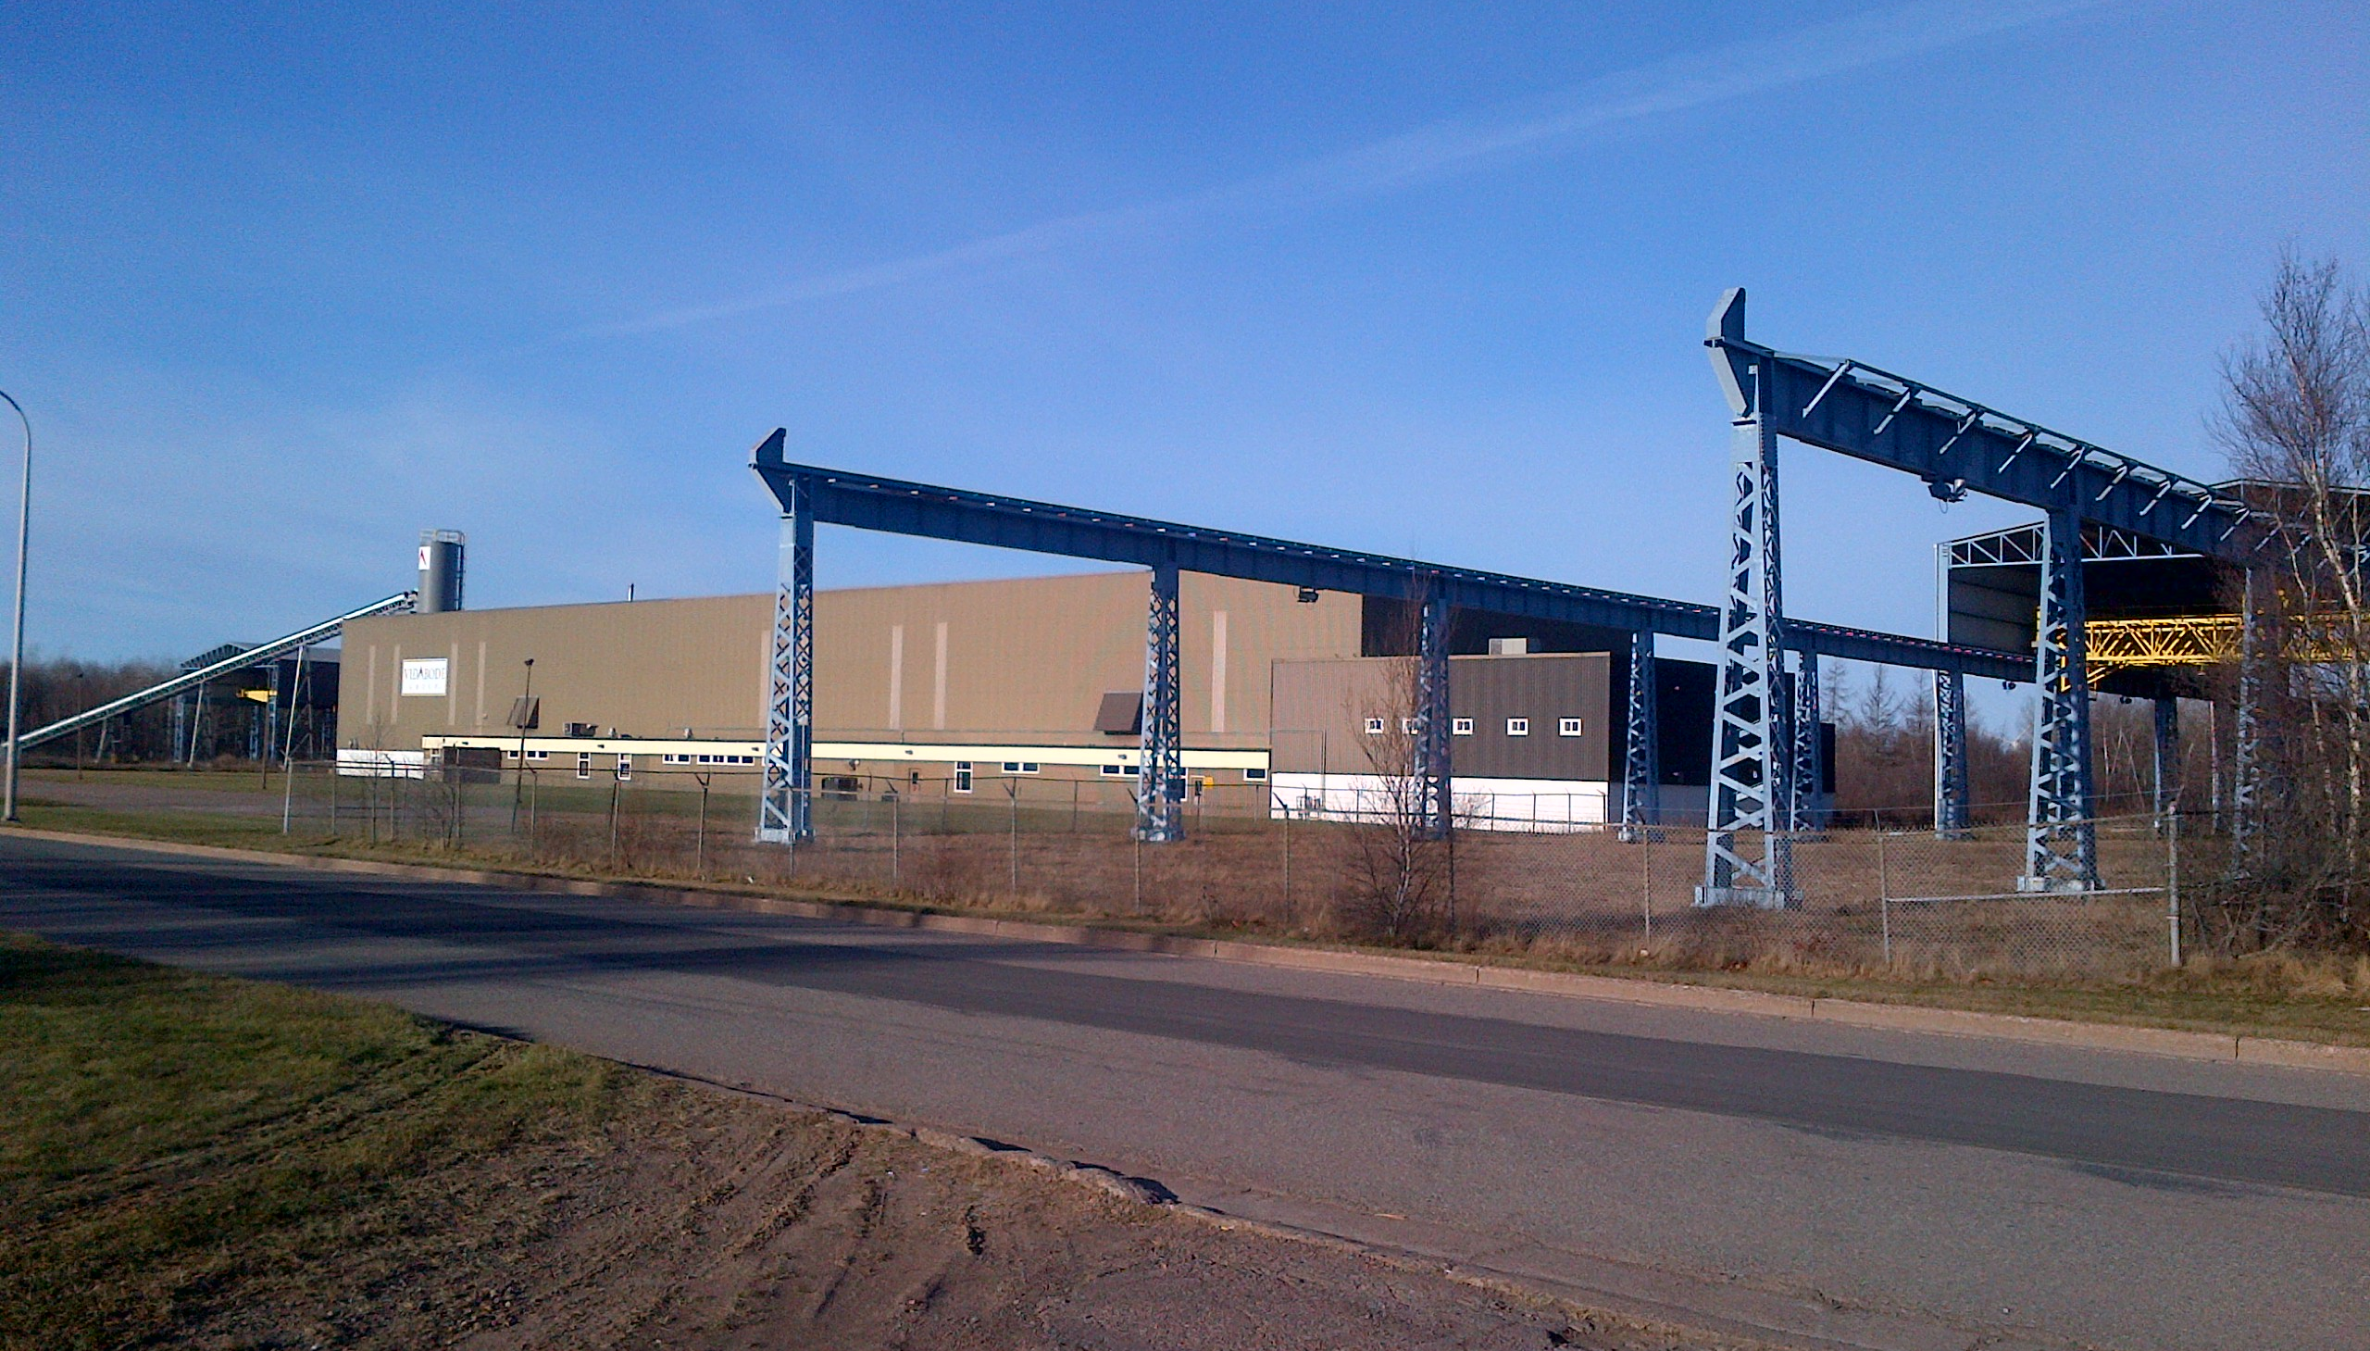
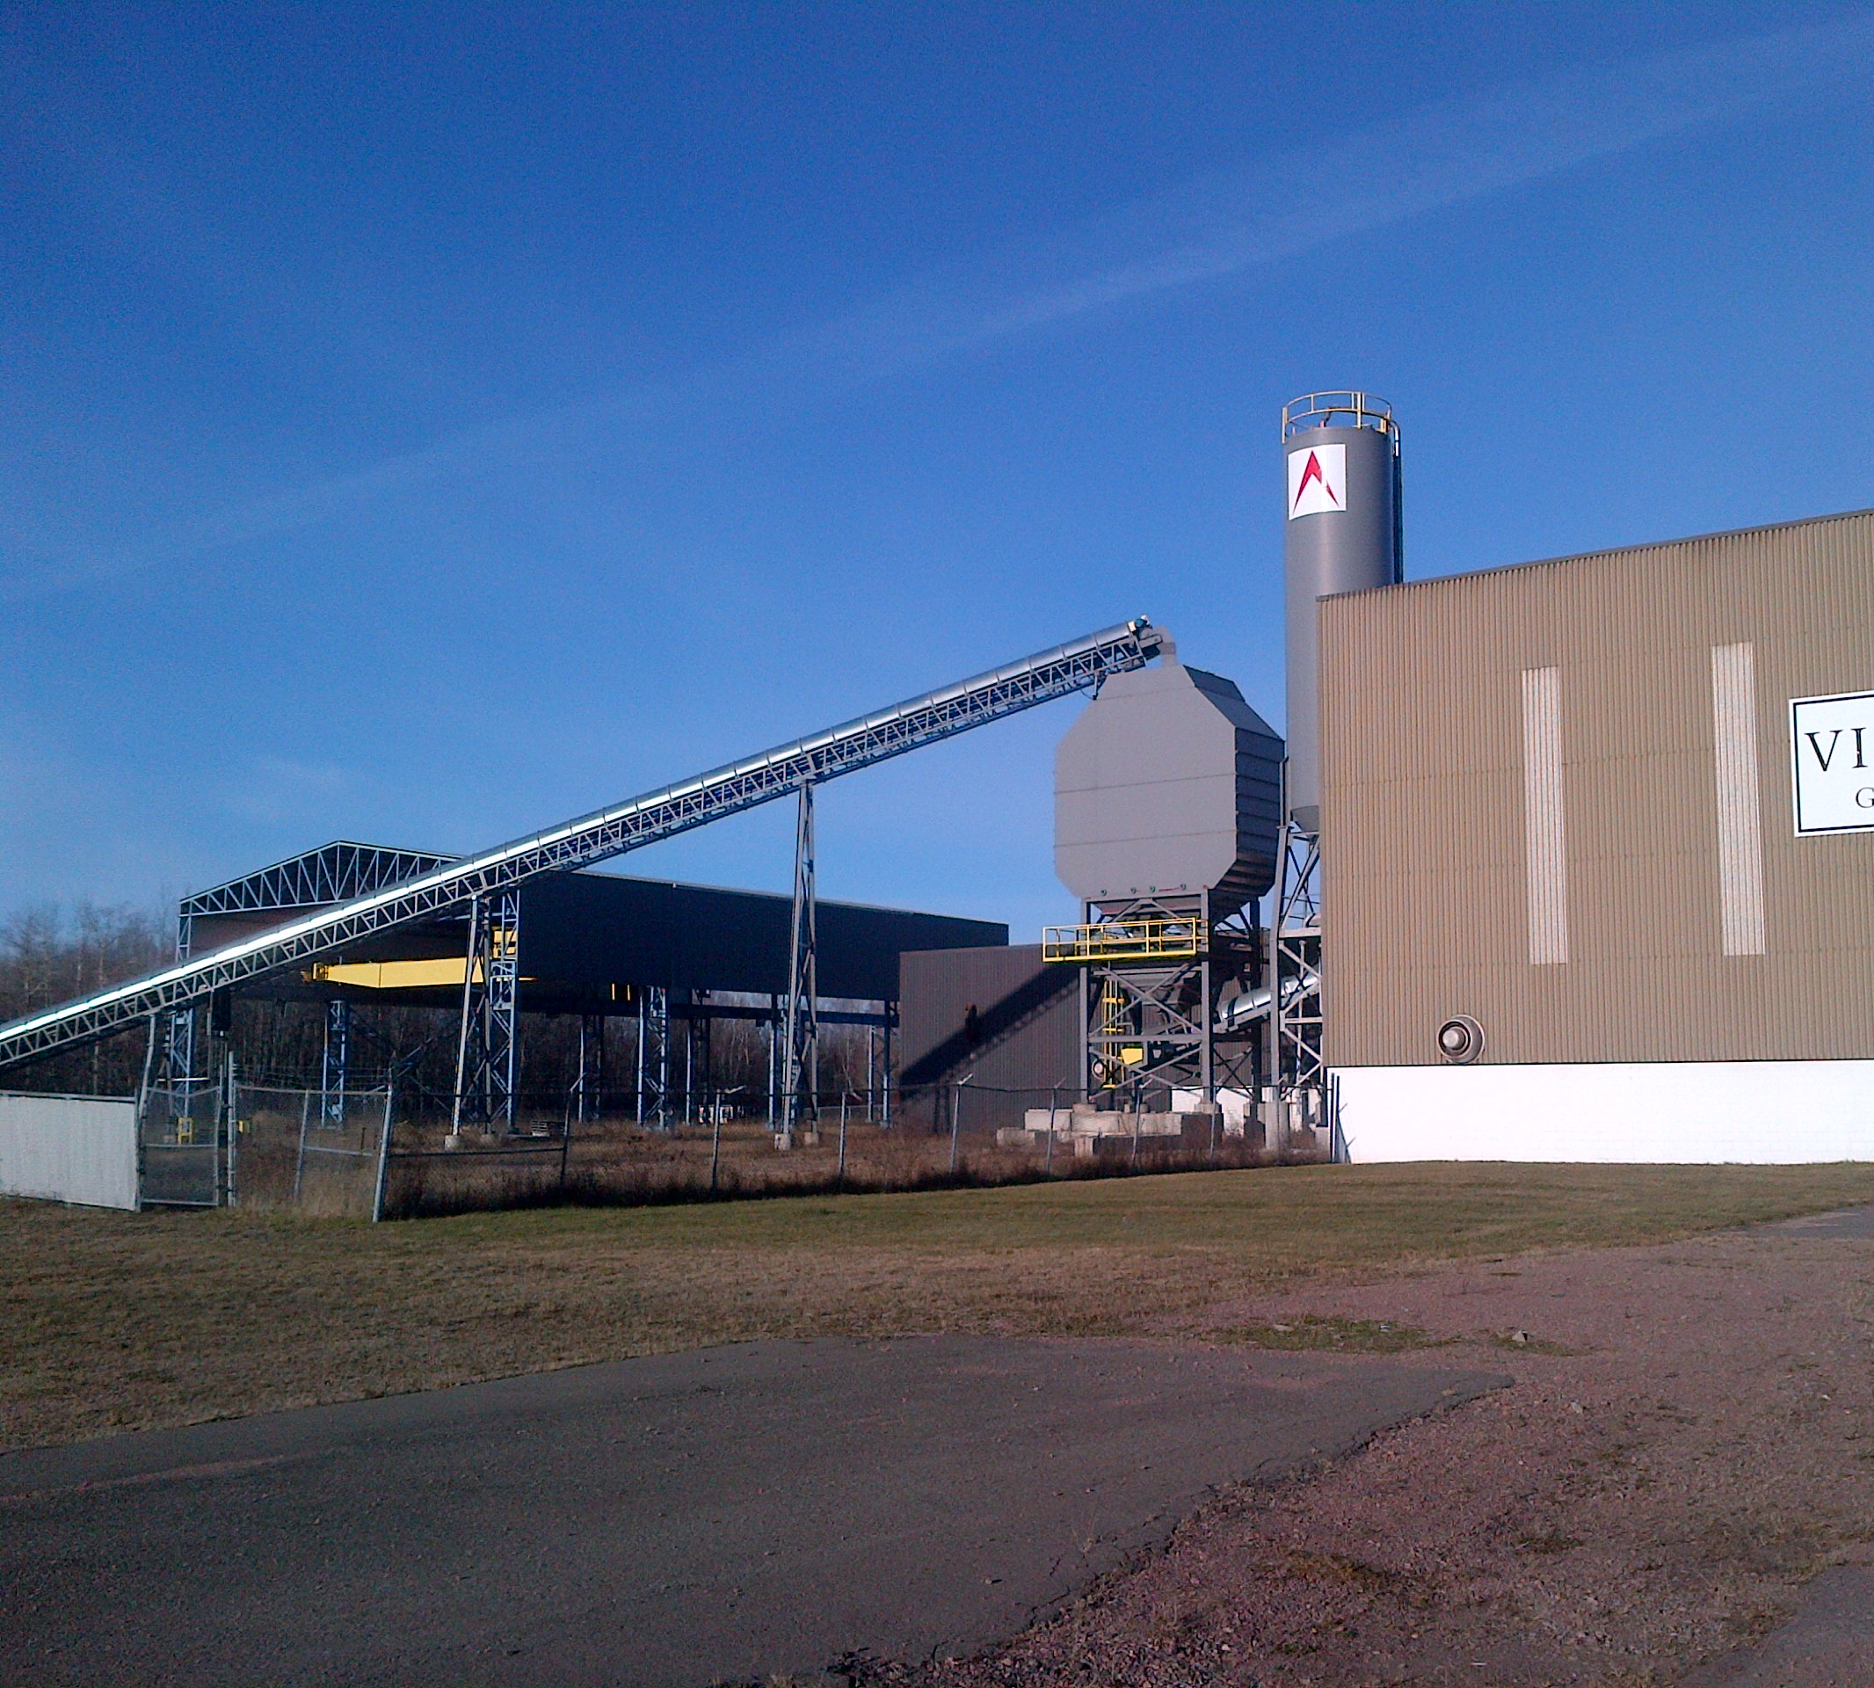
Lot features
27 Acres
Rail Spur To Site (Optional)
Partially Fenced Yard
Two Outdoor Cranes In Addition to Main Building

Slide 4
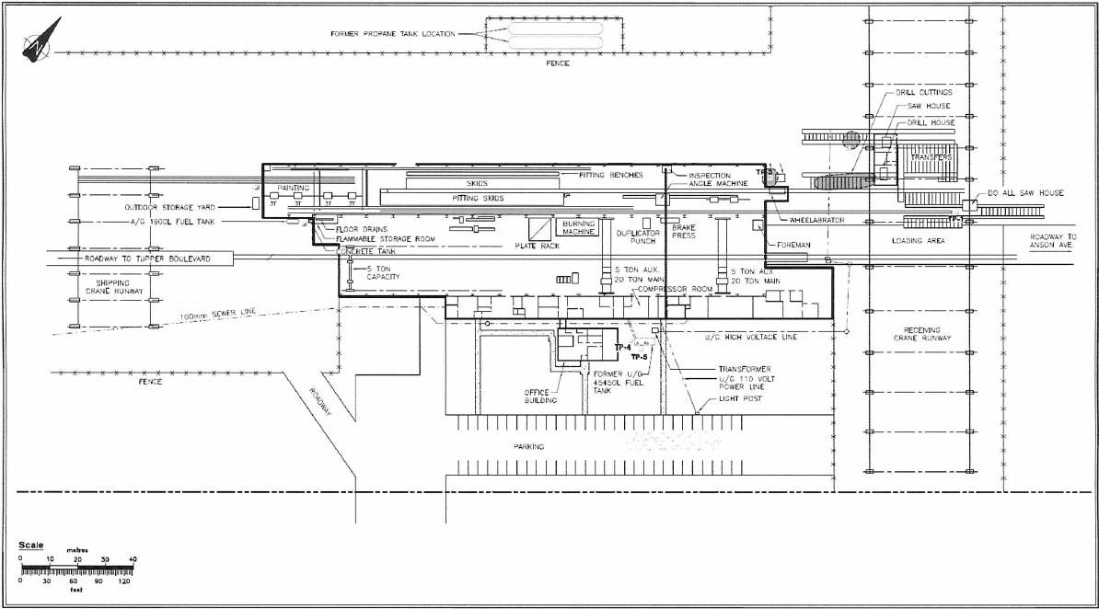
Site Plan

Slide 5
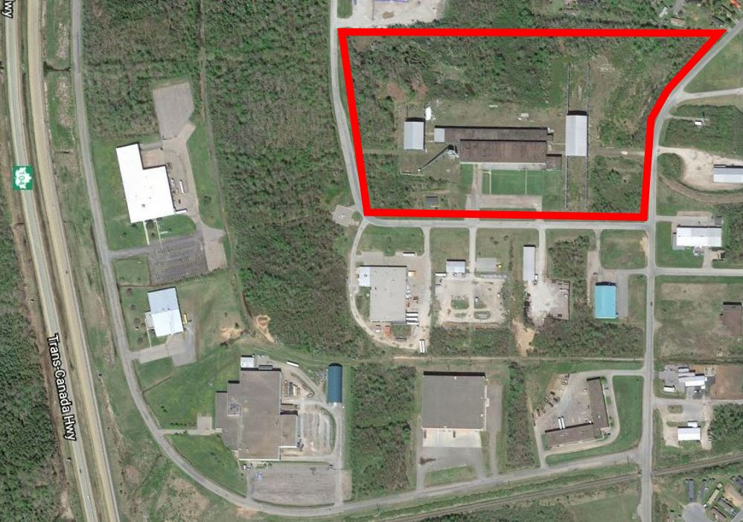
Aerial View
Trans Canada Highway

Slide 6
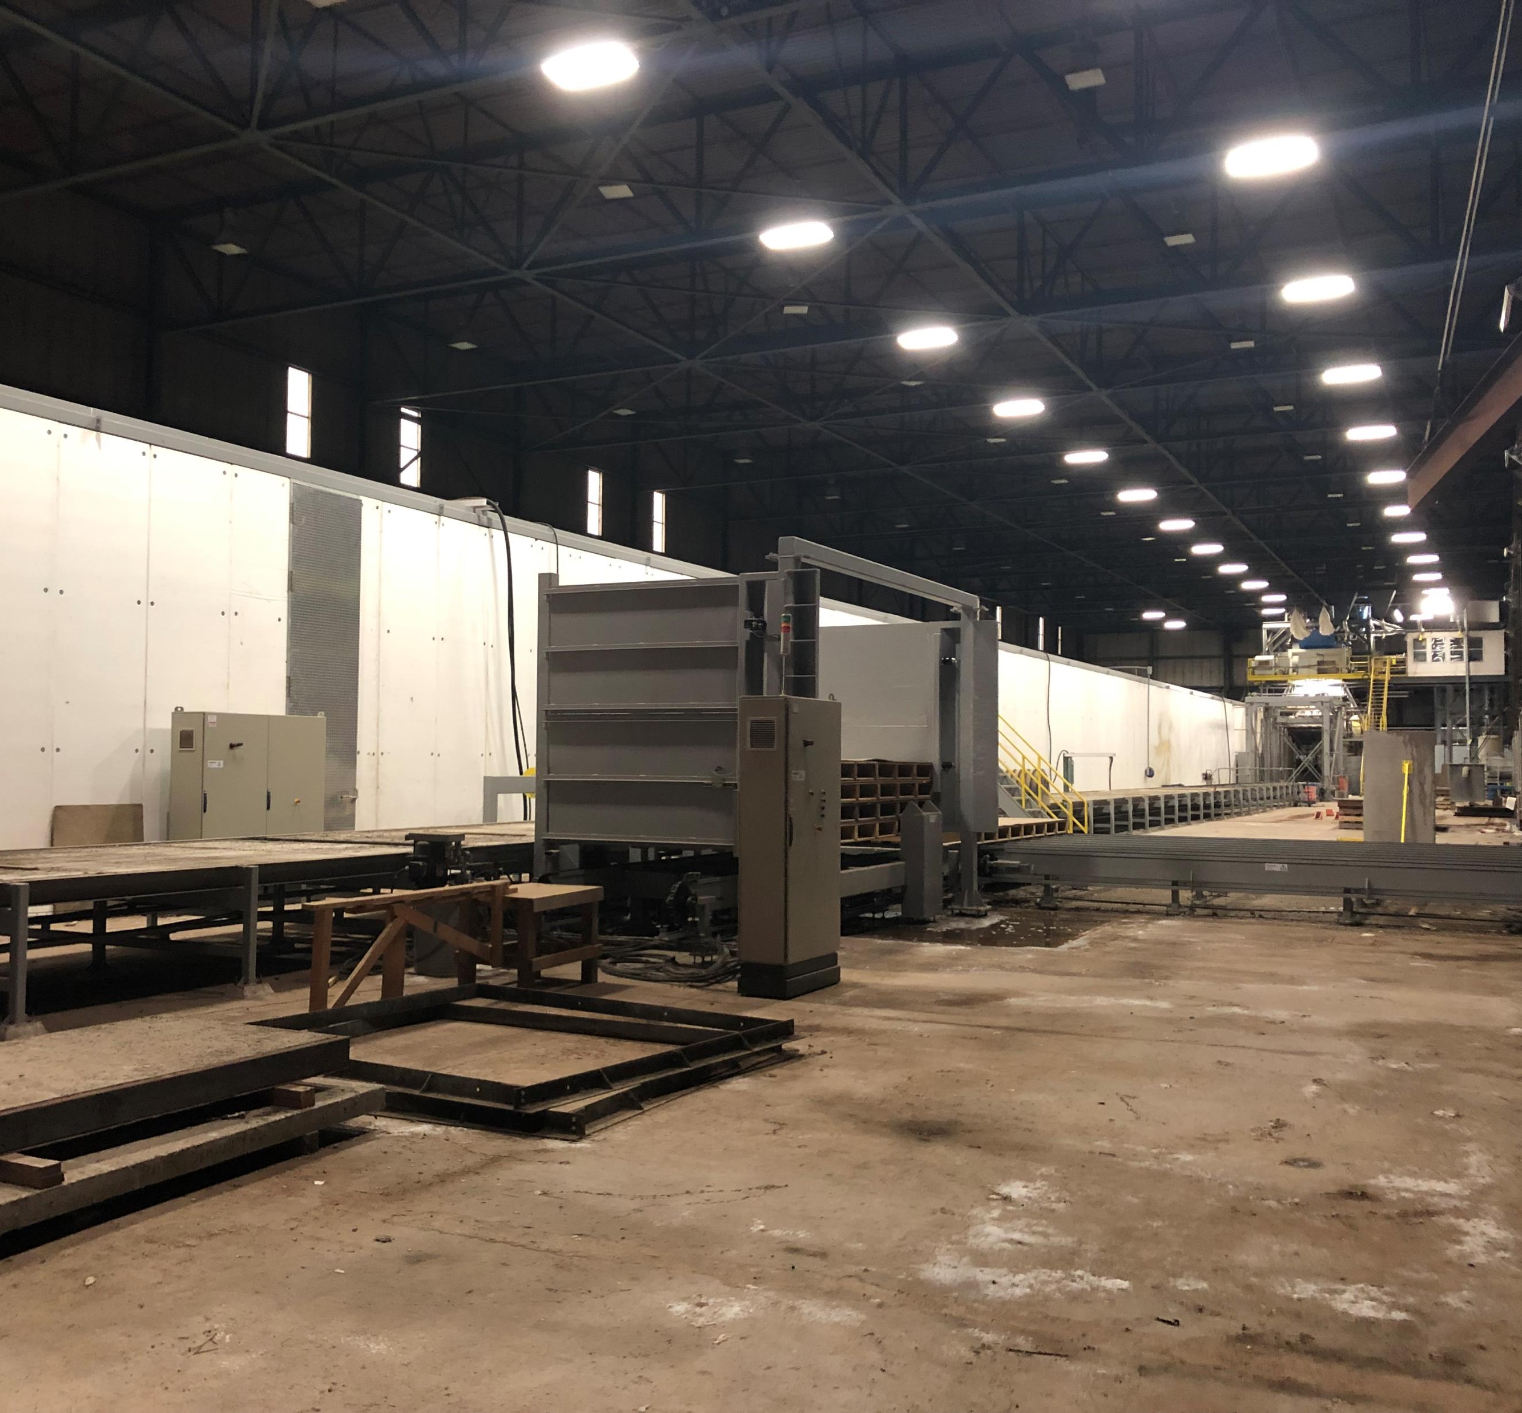
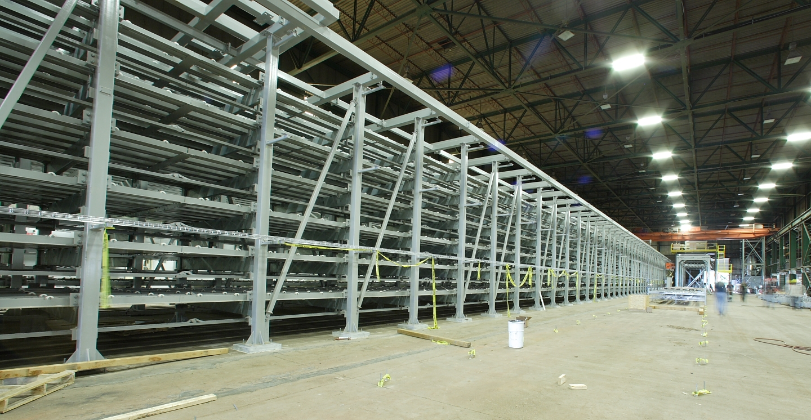
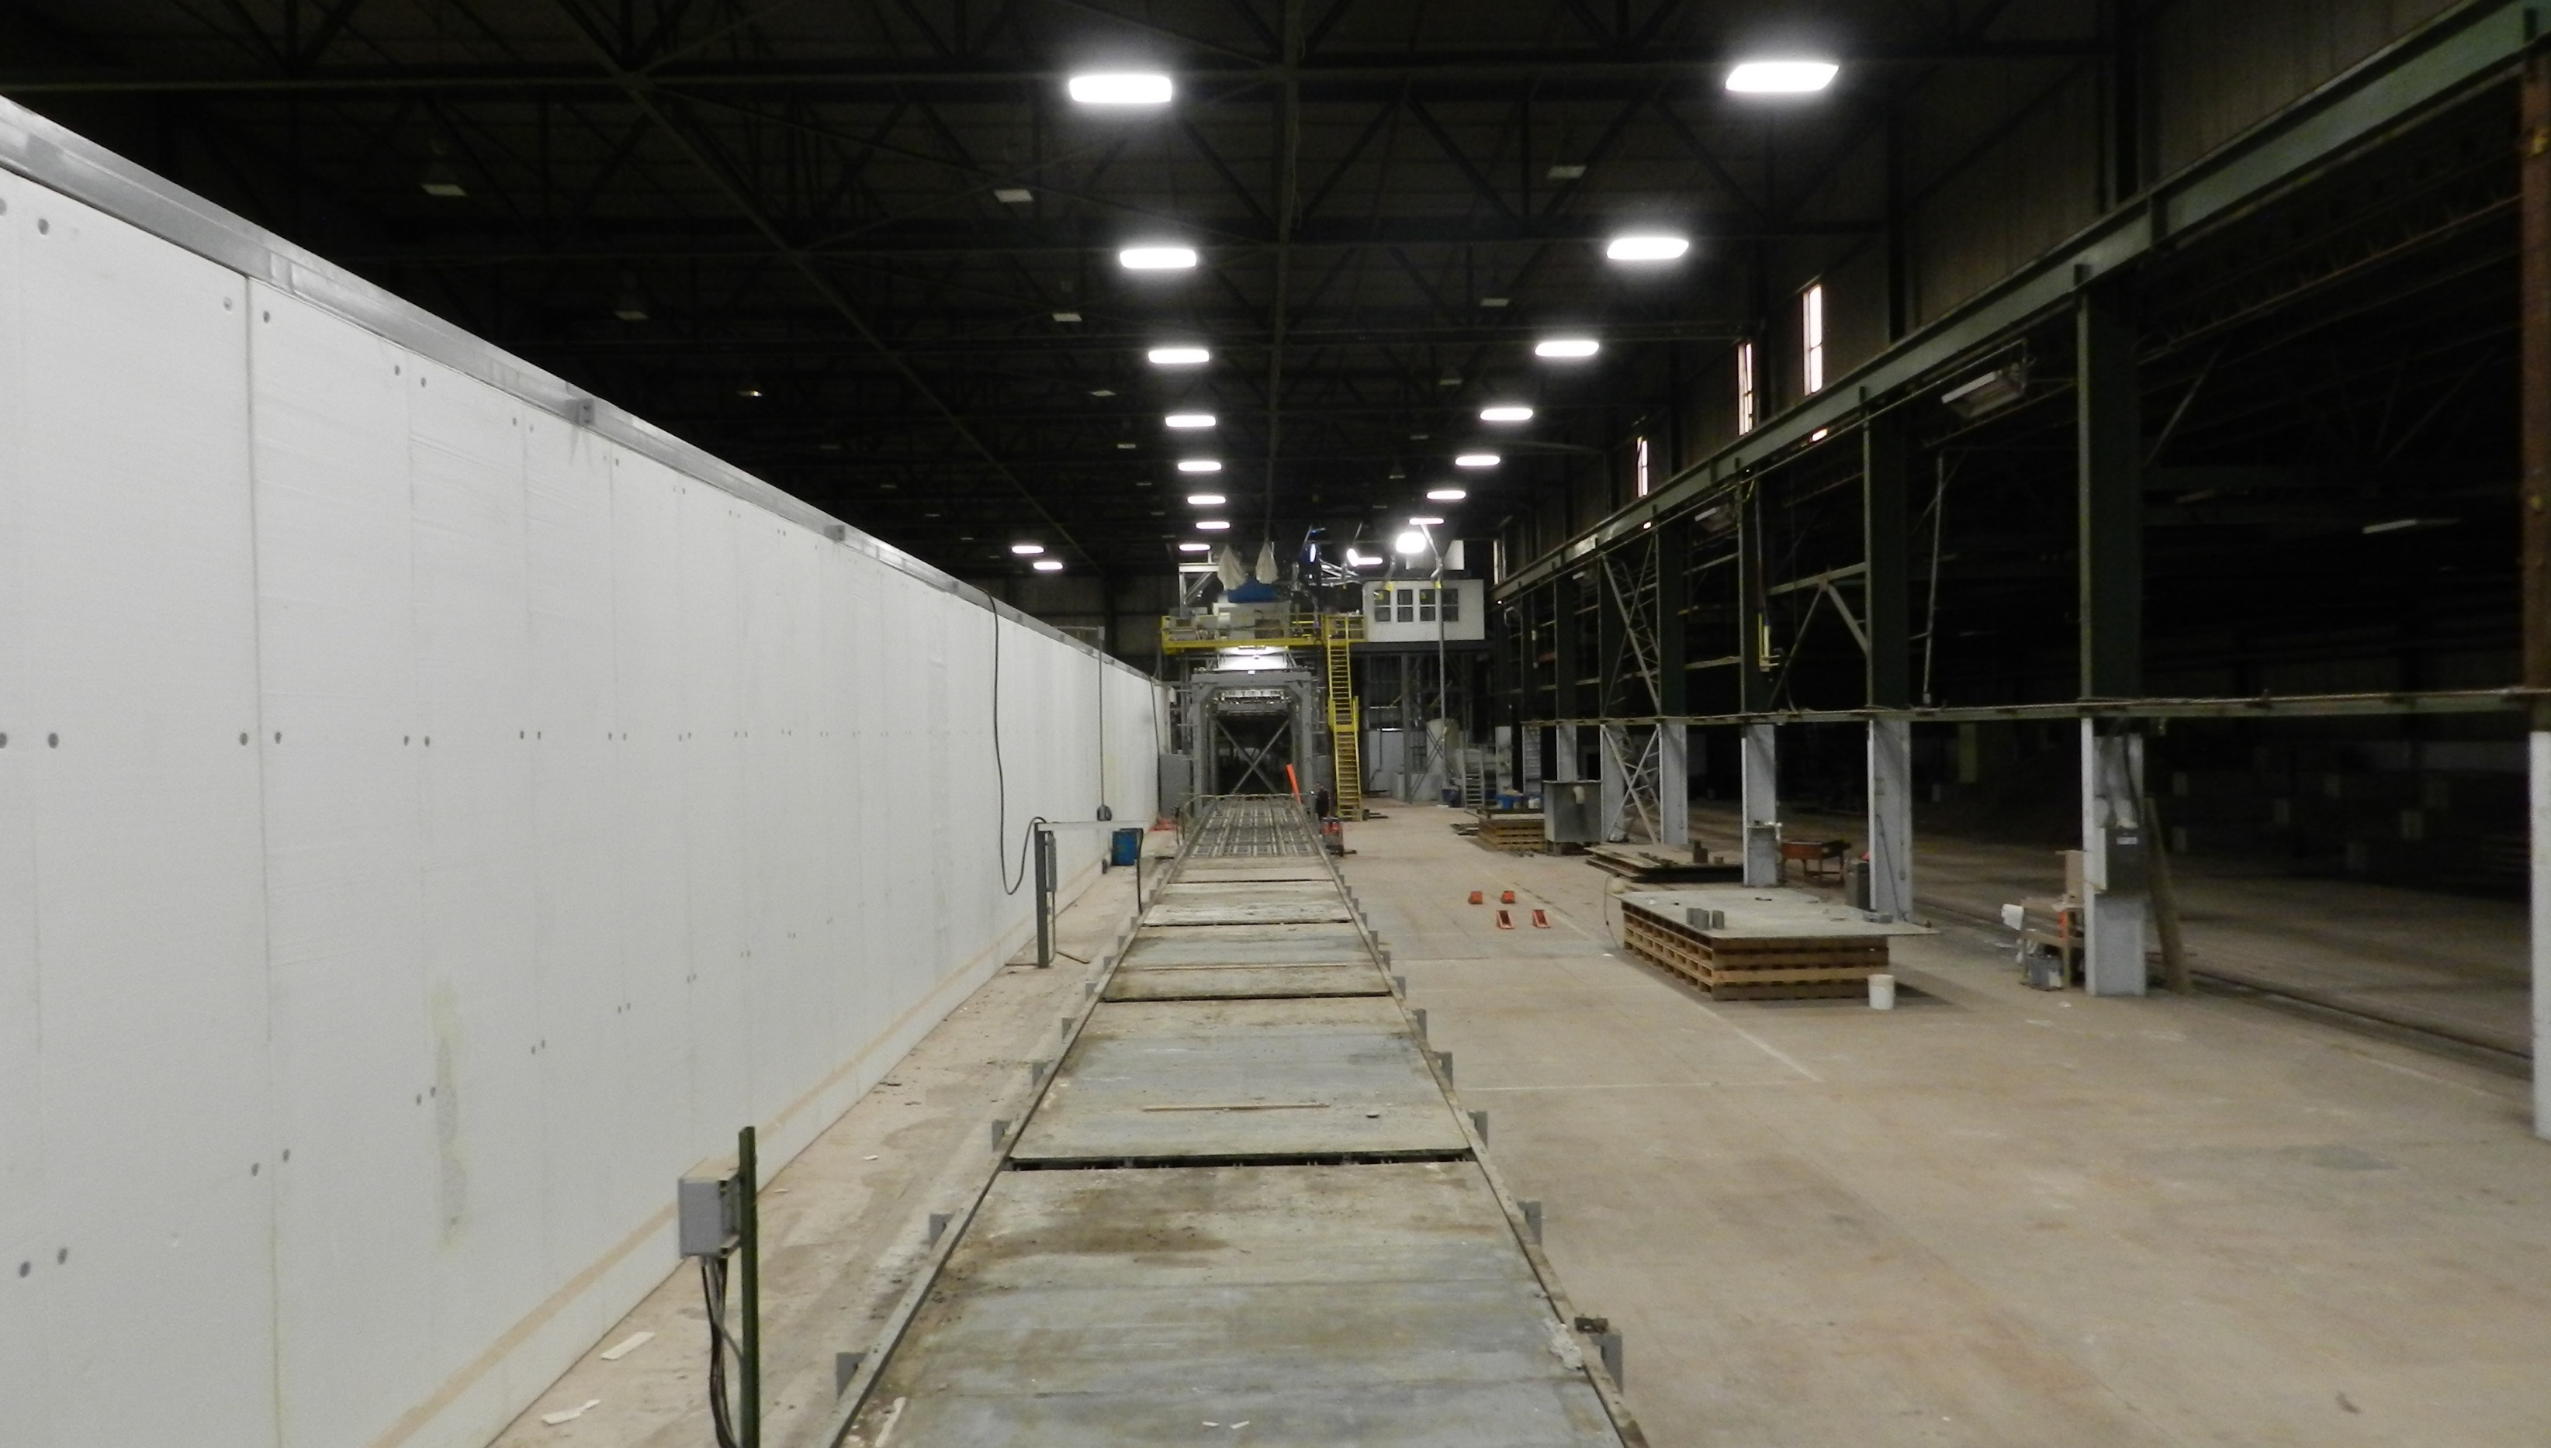
Building interior

Slide 7
Building specs & features
80,000 SF + Exterior Crane Structures
Indoor Cranes (Two x 20 ton and One x 15 ton)
Warehouse and 7 Offices and Engineering Room
28’ - 40’ Ceilings
Security System and Dry Sprinkler System
Heavy Load Capacity Electrical (3 Phase – 1200 Amp)

Slide 8
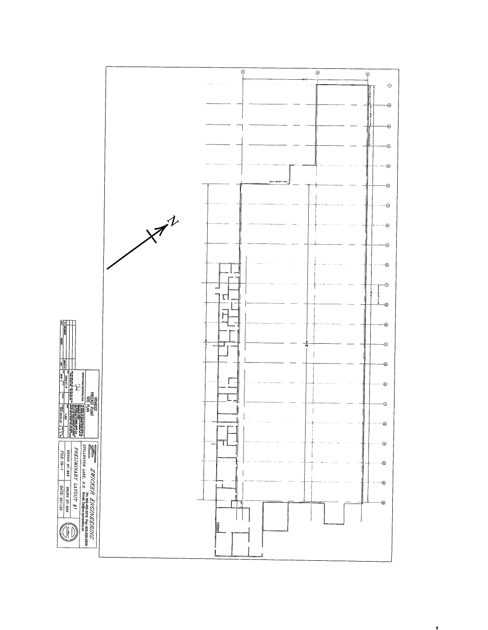
Floor plan

Slide 9
Additional building information
Additional information
Located directly off of the Trans Canada Highway
Industrial Zoning
Prime location to nb and ns ports

Slide 10
Contact Atlantic commercial properties to learn more!
506 853 8000
acp@acpleasing.com
Lahanky@acpleasing.com
Gordon Lahanky
acpleasing.com

